Slide 1

Mushroom Poisoning Resulting in Fulminant Liver Failure
Kai Knudsen
Department of Anesthesia and Intensive Care
http://anesthguide.com

Slide 2
Case Presentation
A 64-year-old woman from Ukraine living in Helsingborg with her two daughters and three grandchildren
Does not speak Swedish or English
History of hypertension; otherwise previously healthy
No significant alcohol consumption
No use of hepatotoxic medications or herbal supplements.
No known pre-existing liver disease
In late July, she collected wild mushrooms and consumed a mushroom stew. One of her daughters ate the same meal but remained asymptomatic

Slide 3
Initial Presentation
The patient presented to the Emergency Department in Helsingborg on August 1st with:
Nausea
Profuse diarrhea. Initially, viral gastroenteritis was suspected
After 3–4 days she developed:
Markedly abnormal liver function tests
Rising aminotransferases
Progressive coagulopathy with increasing INR
Poisoning by either Destroying Angel (Amanita virosa) or Death Cap (Amanita phalloides) was suspected
On August 3rd she deteriorated rapidly with:
Shock
Severe hypotension
The transplant center at Sahlgrenska University Hospital was contacted for evaluation of emergency liver transplantation.

Slide 4
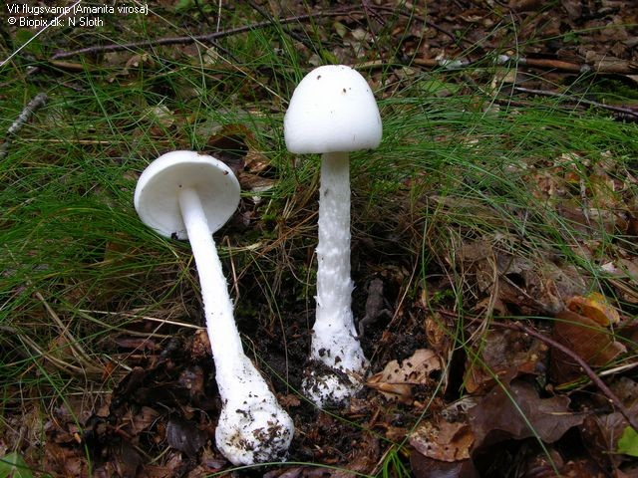
Destroying Angel
(Amanita virosa)
The Destroying Angel is one of the most toxic mushrooms found in Northern Europe.
Characteristics:
Completely white appearance
White cap, gills, stem, ring and volva
Responsible for numerous fatal poisonings worldwide
Because of its attractive appearance, it is occasionally mistaken for edible white mushrooms.
l

Slide 5
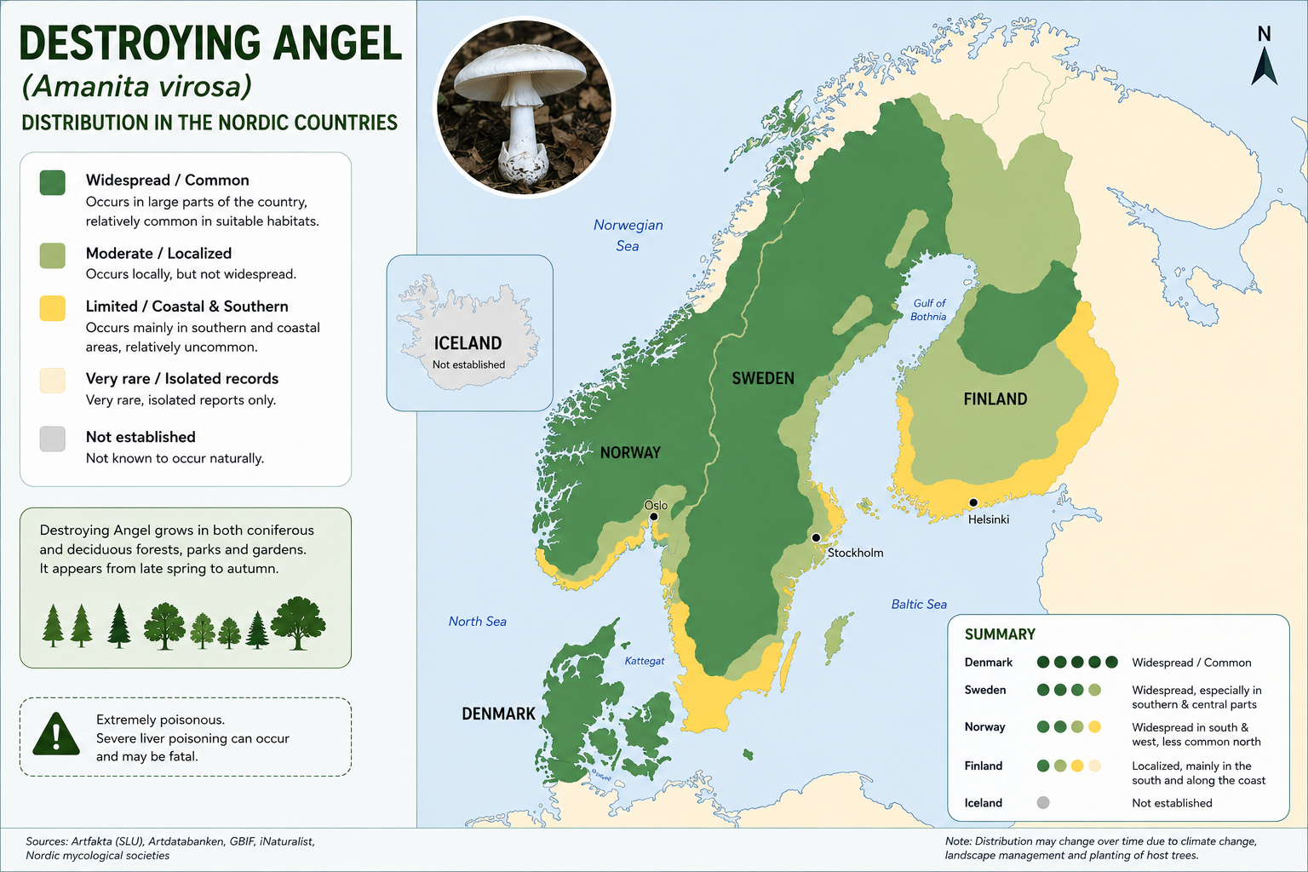

Slide 6
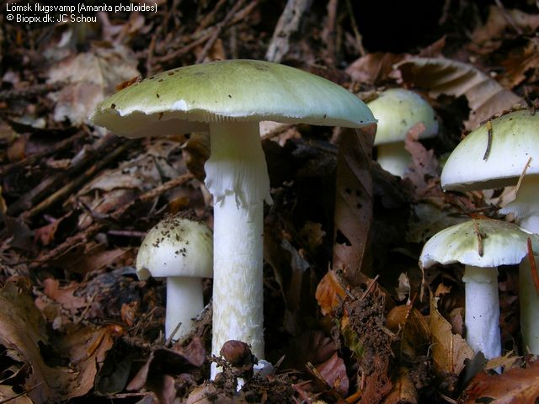
Death Cap (Amanita phalloides)
The Death Cap is responsible for the majority of fatal mushroom poisonings worldwide.
Habitat:
Deciduous forests
Mixed forests
Occasionally grassland
Frequently associated with:
Beech
Oak
Hazel
Distribution:
Southern Sweden
Central Sweden
l

Slide 7
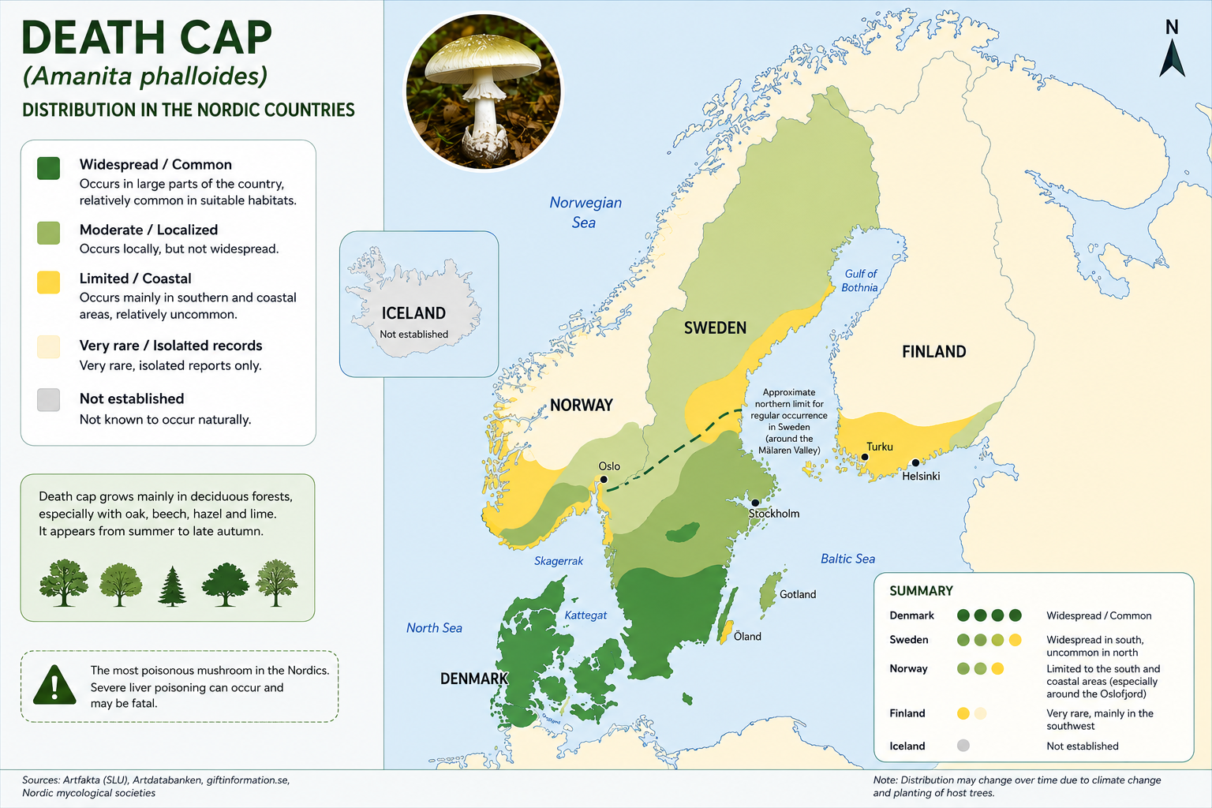

Slide 8
Amatoxin Poisoning
The Swedish Poisons Information Centre recommended immediate antidotal therapy:
  They cause about 300–500 yearly deaths worldwide
  Increasing incidence in South-East Asia
  90–95% of all mushroom deaths
  If you eat some:
  50% chance of AST over 1000
  25% chance of AKI
  Mortality 7–10%

Slide 9
Amatoxin Poisoning
The Swedish Poisons Information Centre recommended immediate antidotal therapy:
Intravenous N-acetylcysteine
Intravenous silibinin
Treatment was initiated urgently in Helsingborg on August 3rd.
Laboratory findings: INR: 8.0 Lactate: 14 mmol/L pH: 7.1
Aminotransferases approximately 80 μkat/L
Clinical deterioration:
Grade II hepatic encephalopathy in the morning
Grade III hepatic encephalopathy by the afternoon
Progressive hemodynamic instability
Treatment included:
Norepinephrine + Vasopressin
The patient was intubated and airlifted to Sahlgrenska University Hospital.
The flight physician expressed concern that she might not survive transport.

Slide 10
Human data – toxic dose
Amatoxin dose:
Historically, it has been described as 0.1 mg/kg.
However, we can assume that it is probably higher, between 0.1 and 1.0 mg/kg
Mushroom dose: Varies between species, geographic location, and which part of the mushroom is consumed.
We can assume that a critical amount would be approximately 60–100 g of fresh mushroom (5–10 g dry weight).
This corresponds to an amatoxin content of approximately 1 mg/g dry weight.

Slide 11
Arrival at ICU Sahlgrenska
On arrival the patient demonstrated:
Circulatory shock
Fulminant acute liver failure
Acute kidney injury
Severe coagulopathy
Investigations:
CT brain: no acute pathology
CT chest: bibasal atelectasis only

Slide 12
Abdominal CT Findings
Abdominal CT demonstrated:
Peripancreatic inflammatory changes, possibly secondary to shock
Terminal ileitis/colitis, potentially related to amatoxin toxicity or circulatory failure
Reduced hepatic contrast enhancement consistent with fulminant liver failure
Secondary gallbladder edema
If extensive confluent hepatic necrosis had been demonstrated, emergency hepatectomy while awaiting transplantation would have been considered.

Slide 13
Cardiac Assessment
Transthoracic echocardiography showed:
Hyperdynamic circulation
No significant valvular disease
Mildly elevated pulmonary artery pressure
Findings were considered secondary to the hyperdynamic circulatory state associated with acute liver failure.

Slide 14
Acute Liver Failure: Multidisciplinary Evaluation
August 4th: An emergency liver transplant board meeting was convened including: Hepatologists, Nephrologists, Transplant surgeons, Anesthesiologists, Intensivists, Transplant coordinators, Transplant nurses
Outcome: Accepted for emergency liver transplantation
Listed as Urgent Call
Blood group O
Because of expected ABO incompatibility issues, plasma exchange was planned to reduce anti-A and anti-B antibody levels.
During the night:
Progressive vasoplegia
Increasing vasopressor requirements
Management:
PiCCO monitoring initiated
Continuous renal replacement therapy (CRRT) started

Slide 15
Progressive Organ Failure
August 5th: Laboratory findings:
Falling aminotransferases
INR increased to 7.1
Lactate decreased to 7 mmol/L (24 mmol/L on arrival)
Ammonia: 414 μmol/L
CRRT dose: 80 mL/kg/hour
Sodium target: 145–148 mmol/L
Temperature maintained within target range
Persistent metabolic acidosis
  pH approximately 7.25
  Base excess −10
Severe hypoglycemia
  Continuous infusion of 20% glucose
Empirical antimicrobial therapy: Meropenem, Anidulafungin (Ecalta) Vancomycin

Slide 16
Plasma Exchange and Massive Transfusion
Plasma exchange was initiated in parallel with CRRT.
Complications:
Acute gastrointestinal bleeding
Severe thrombocytopenia
Ongoing transfusion requirements
Treatment included:
9 units packed red blood cells within 24 hours
Multiple platelet transfusions
Repeated calcium supplementation
Sodium bicarbonate therapy
Lactate remained between 5–7 mmol/L
Additional sodium supplementation was added to dialysis fluids

Slide 17
Preparation for Transplantation
Two sessions of high-volume plasma exchange were completed.
Complications:
Central venous pressure increased to approximately 20 mmHg
Significant fluid overload despite CRRT
Repeat echocardiography demonstrated:
Volume overload
Persistently elevated filling pressures
A suitable donor organ became available.
The patient remained approximately 5 kg fluid positive prior to surgery.
Transferred to the operating room at 02:30 on August 6th.

Slide 18
Emergency Liver Transplantation
Liver transplantation commenced during the night of August 6th.
At induction: CVP: 20–24 mmHg Desired CVP: <8 mmHg
Management: CRRT increased to 400 mL/hour ultrafiltration
Ketamine Fentanyl Sevoflurane Rocuronium
Hemodynamic support:
Norepinephrine 0.3–1.1 μg/kg/min + Vasopressin infusion
Blood loss: 1.2 L 4 units RBC 3 units plasma 4 platelet units
The patient developed: Electrical storm
Recurrent ventricular tachycardia/ventricular fibrillation
Treatment:
7 defibrillations
Magnesium
Amiodarone

Slide 19
Intraoperative Cardiovascular Collapse
During transplantation:
Severe electrical instability
Repeated cardiovascular collapse
Multiple episodes requiring chest compressions
After administration of:
Amiodarone 300 mg
The arrhythmias gradually stabilized
Respiratory status worsened:
FiO₂ 65–70%
PEEP 10 cm H₂O
Following successful transplantation, the patient was transferred back to the ICU.

Slide 20
Early Postoperative Course
The first postoperative day was characterized by:
Persistent hemodynamic instability
Generalized edema
Ongoing liver dysfunction
Renal failure
Coagulopathy
The major clinical problem was refractory ventricular arrhythmias
During the first postoperative night:
Defibrillated 15 times
Antiarrhythmic management included:
Lidocaine infusion
Trial of esmolol (poorly tolerated)
Consideration of fosphenytoin and stellate ganglion blockade
After magnesium bolus followed by continuous infusion, arrhythmias gradually resolved.

Slide 21
Subsequent ICU Course
The patient subsequently stabilized.
Ventricular arrhythmias resolved
Milrinone therapy continued
Ongoing CRRT
Additional findings:
Persistent discrepancy between radial and femoral arterial pressures
Bronchoscopy revealed blood-stained secretions, which were successfully removed
Respiratory improvement:
FiO₂ reduced from 60% to 40% by August 9th
A tracheostomy was performed on August 13th.

Slide 22
Recovery Following Liver Transplantation
The patient's hemodynamic status gradually improved.
Progressive improvement in liver function tests
Gradual recovery of cardiac function
Following sedation withdrawal, the patient slowly regained consciousness but remained:
Tracheostomized
Mechanically ventilated
Unable to move either upper or lower extremities
Neurological examination revealed:
Flaccid tetraparesis
Absence of deep tendon reflexes
Investigations:
MRI of the brain and spinal cord showed no abnormalities
The patient underwent prolonged ventilator weaning.
On August 22nd she was transferred to her local hospital in Helsingborg for continued intensive care management.
At transfer she was able to sit at the bedside with assistance.

Slide 23
Long-Term Outcome
The patient experienced a prolonged ICU and hospital course.
Major complication:
Critical illness myopathy
Over time gradual neurological recovery
Discharged shortly before Christmas
Total hospitalization approximately 4 months
At a follow-up video consultation in January: Alert and communicative through an interpreter Strong voice Good interaction and cognitive function Living with her daughter Actively helping care for her grandchildren
Residual symptoms:
Persistent fatigue
Reduced exercise capacity
Clinical status:
Blood pressure: 120/70 mmHg Weight: 60 kg Estimated GFR: 52 mL/min
Current medications included: Tacrolimus (Dailiport) Mycophenolate mofetil (CellCept) Trimethoprim-sulfamethoxazole (Bactrim) Omeprazole Movicol Potassium supplementation Aspirin BisoprololParacetamol

Slide 24
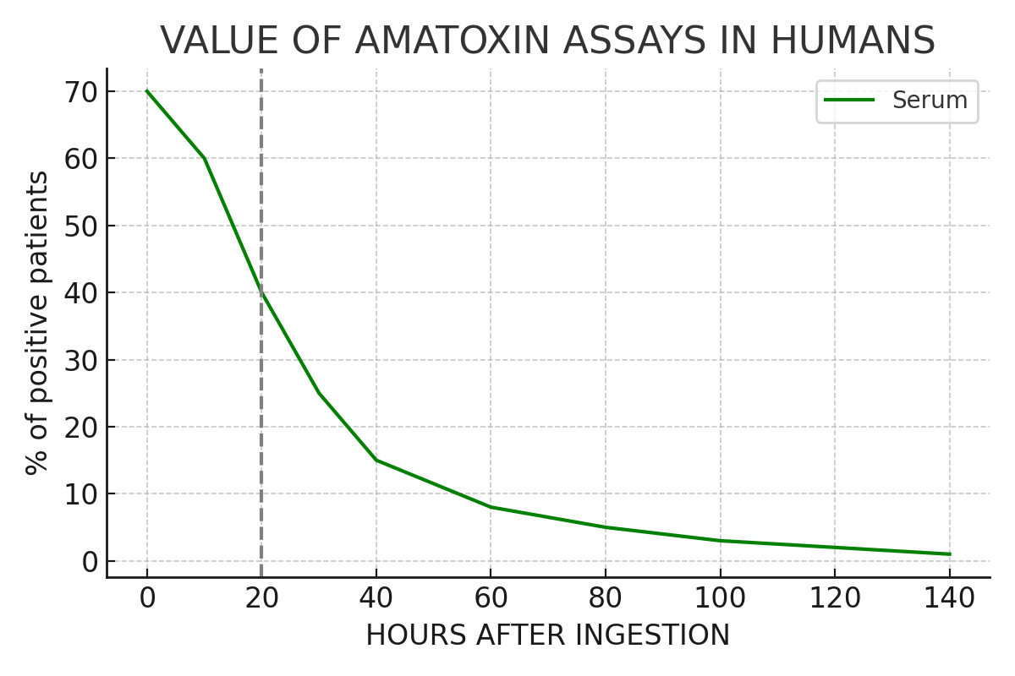
VALUE OF AMATOXIN ASSAYS IN HUMANS

Slide 25
Potential Mechanisms Behind the Electrical Storm
Several mechanisms may have contributed to the severe ventricular arrhythmias observed during transplantation and the early postoperative period.
Structural and Hemodynamic Factors Ventricular stretch, Hyperdynamic circulation, Elevated filling pressures, Severe fluid overload
Metabolic Factors Electrolyte disturbances, Hyperammonemia, Metabolic acidosis, Severe liver failure
Electrophysiological Factors
Altered calcium homeostasis
Altered potassium currents
Prolonged myocardial repolarization
Additional Factors
Myocardial ischemia
Vasopressor therapy
Reperfusion injury
Toxic effects of amatoxin

Slide 26
Cardiovascular Effects of Mushroom Poisoning
Erenler et al. investigated cardiovascular manifestations associated with mushroom poisoning.
Key findings:
Sinus tachycardia was the most common ECG abnormality
Additional findings included:
  Sinus arrhythmia
  ST-T wave abnormalities
  First-degree AV block
  QT prolongation
Patients with delayed symptom onset (>6 hours) demonstrated:
Higher prevalence of tachycardia
Increased blood pressure
The authors concluded that mushroom poisoning may produce significant cardiovascular effects, particularly tachyarrhythmias in patients with delayed-onset toxicity

Slide 27
Hepatocellular Injury in Amatoxin Poisoning
The liver is the primary target organ, although significant renal injury may also occur
Amatoxin-containing mushrooms cause severe hepatocellular injury through inhibition of RNA polymerase II.
Consequences include:
Inhibition of protein synthesis
Progressive hepatocyte necrosis
Massive hepatic cell death
Fulminant liver failure
Multi-organ dysfunction

Slide 28
Initial Management
Identify the Mushroom
Whenever possible:
Obtain photographs
Preserve mushroom remnants
Consult a mycologist or mushroom expert
Accurate species identification may significantly influence treatment decisions

Slide 29
Gastrointestinal Decontamination
Gastric emptying may be considered when:
Presentation occurs within 6–8 hours of ingestion
Ideally within the first hour
Gastric evacuation is generally avoided in patients with persistent vomiting.

Slide 30
Treatment of Amatoxin Poisoning
Management includes:
Early gastrointestinal decontamination
Repeated activated charcoal administration
Specific antidotal therapy
Intensive organ support
Liver transplantation when indicated

Slide 31
Activated Charcoal and Symptomatic Therapy
Activated Charcoal
Repeated-dose activated charcoal:
50 g orally four times daily in adults
10–25 g in children
May be administered for 2–3 days following ingestion.
Antiemetics
Ondansetron 4 mg IV
Granisetron 1 mg IV
Seizures or Agitation
Benzodiazepines:
Diazepam 5–10 mg IV

Slide 32
Silibinin (Legalon SIL)
Silibinin is currently regarded as the most important specific therapy for amatoxin poisoning.
Characteristics:
Purified extract of silymarin
Derived from milk thistle (Silybum marianum)
Used medicinally for centuries
Mechanism:
Inhibits hepatic uptake of amatoxins
Reduces hepatocellular injury
Improves transplant-free survival

Slide 33
Silibinin Therapy
Indications:
Amanita virosa
Amanita phalloides
Galerina marginata
Recommended dosage: 20 mg/kg/day for 2 days
Divided into four doses
Administration:
5 mg/kg per infusion
Infused over 2 hours
Repeated every 4 hours
Monitoring:
Fluid balance
Electrolytes
Liver function tests

Slide 34
High-Dose Penicillin G
When silibinin is unavailable:
Penicillin G
5 g IV four times daily
Duration: 3 days
Historically used in severe amatoxin poisoning.
Although evidence is limited, it remains a therapeutic option in some centers.

Slide 35
N-Acetylcysteine (NAC)
NAC is commonly administered in severe amatoxin poisoning.
Standard regimen:
Loading Dose
150 mg/kg IV over 1 hour
Second Infusion
50 mg/kg over 4 hours
Third Infusion
100 mg/kg over 16 hours
Total dose:
300 mg/kg over 20 hours
This regimen is similar to that used for acetaminophen toxicity.

Slide 36
Advanced Extracorporeal Therapies
Hemoperfusion
Activated charcoal hemoperfusion may be considered early after ingestion.
Forced Diuresis
May be considered during early Cortinarius rubellus poisoning.
MARS Therapy
Molecular Adsorbent Recirculating System (MARS) may be considered in:
Severe amatoxin poisoning
Fulminant liver failure
Patients awaiting transplantation

Slide 37
Supportive Treatment
Acute Kidney Injury
Renal replacement therapy when indicated
Acute Liver Failure
Management includes:
Intensive care monitoring
Correction of coagulopathy
Vitamin K administration
Treatment of cerebral edema
Management of metabolic disturbances

Slide 38
Treatment of Amatoxin Poisoning
Early gastrointestinal decontamination
Repeated activated charcoal administration
Specific antidotal therapy via OATP blockade
preferred: silibinin (Loading dose: 5 mg/kg 1 hour, followed by 20 mg/kg/day)
alternatives: penicillin, rifampicin (oral silymarin)
Reduce Oxidative Stress and Liver Injury
  → N-acetylcysteine (Loading dose: 150 mg/kg 1 hour, followed by 20 mg/kg/day)
Hyperhydration
  → dilution to prevent kidney damage
Intensive organ support
Liver transplantation when indicated

Slide 39
Liver Transplantation
Liver transplantation remains the definitive treatment for advanced amatoxin-induced liver failure.
Indications include:
Fulminant hepatic failure
Progressive encephalopathy
Severe coagulopathy
Refractory metabolic instability
Progressive multi-organ failure
Successful transplantation can be life-saving even in critically ill patients such as the case presented here

